Slide 1
AI Fundamentals Series
Suryatapa Roy
Developer Lead, GDG-YYC
Data Scientist NLP, CHATA
MSc in integrating ML into VR, Prof. Yaoping Hu, University of Calgary

Slide 2
SETUP
Install Python
Install Anaconda
Setup environment
Conda create –n torchpy python=3.7
Conda activate
Install CUDA Toolkit If you are on a gpu system
Check python torch version console and notebook
https://docs.conda.io/projects/conda/en/4.6.0/_downloads/52a95608c49671267e40c689e0bc00ca/conda-cheatsheet.pdf
https://drive.google.com/file/d/1wMjG_-KHTpo8aP1Q2u_OaclVnUlcy9ms/view?usp=sharing
https://github.com/GDGCloudCalgary/ai_fundamentals_sessions
https://www.youtube.com/playlist?list=PLPfUOXm_B7SzchTr3_RDoB5rZ2O6HOmEn
https://gdg.community.dev/gdg-cloud-calgary/#

Slide 3
Installation PyTorch
https://pytorch.org/
https://www.youtube.com/watch?v=BzcBsTou0C0&list=PLQVvvaa0QuDdeMyHEYc0gxFpYwHY2Qfdh&index=1
https://www.youtube.com/watch?v=exaWOE8jvy8&list=PLqnslRFeH2UrcDBWF5mfPGpqQDSta6VK4&index=2

Slide 4
Supervised Machine Learning
How much of x1, x2, x3 should be put together to make y1
Given many different y1 under different cases , measure x1, x2, x3 and find a logical relation….
Once logical relation understood – can make a general state of y1 or given y1 can predict how much each x was in it….
Given y1, y2, y3 that are different states of Y (system output/ types of things…) that are each caused by x1, x2, x3 states of X
Once you learn the logical relation between X and y1 and relation between X and y2 and so on – given composition of X – you can predict Y
Y can be a continuous value – Regression Problem
Y can be a finite discrete state problem – True/False or class between 1 to 10 –Probabilistic Problem
https://machinelearningmastery.com/a-tour-of-machine-learning-algorithms/

Slide 5
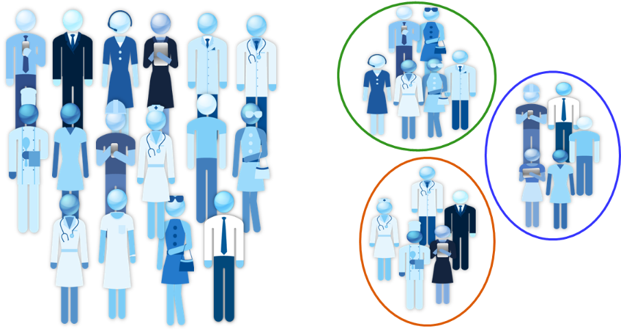
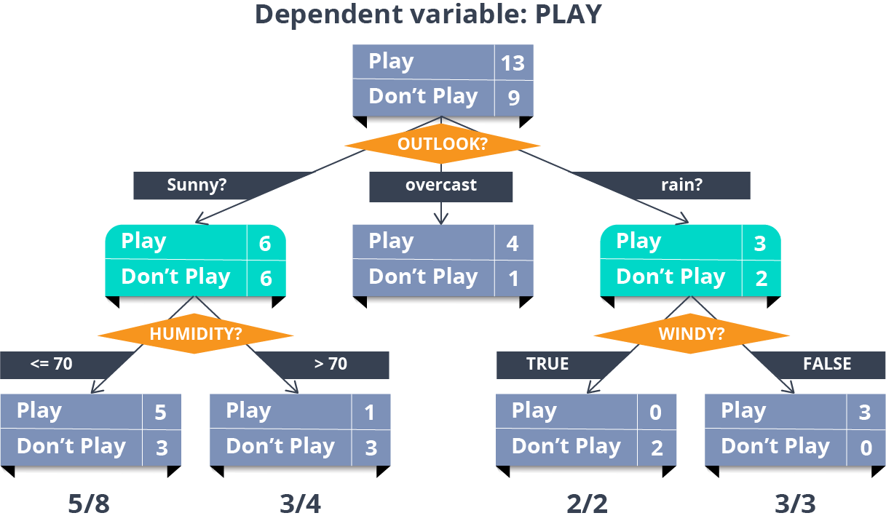
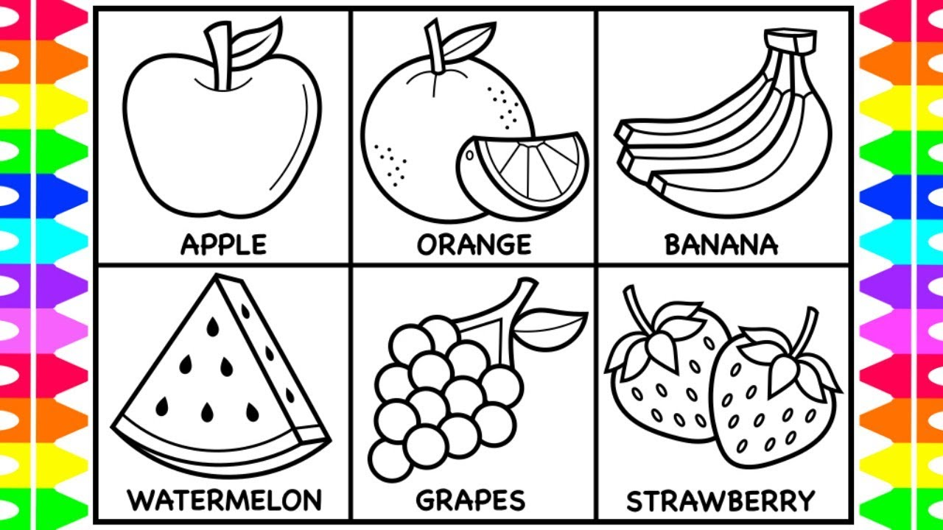
Un-Supervised Machine Learning
https://machinelearningmastery.com/a-tour-of-machine-learning-algorithms/

Slide 6
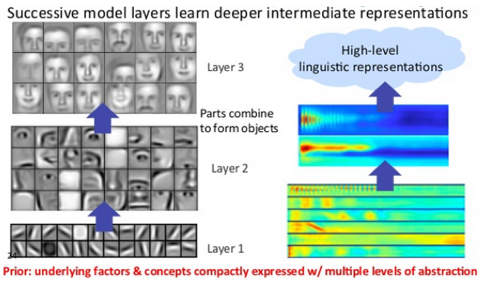
Deep Learning
Complex Problem – Hidden Patterns – Rules
Different Levels of Rules Patterns ; Many Labels Possible

Slide 7
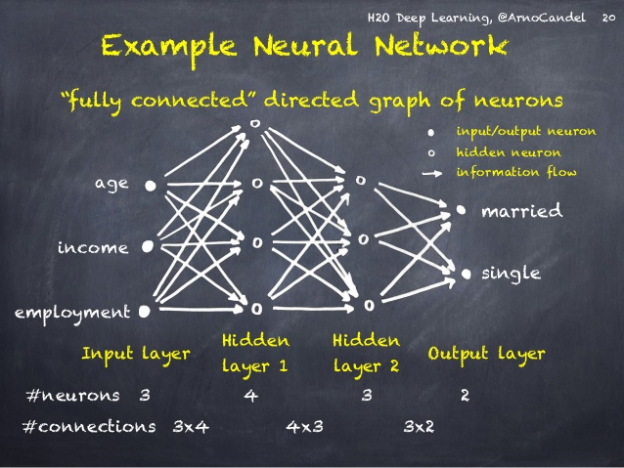
Typical Neural Network

Slide 8
PyTorch
Follow up tutorials this week:
https://www.youtube.com/watch?v=9j-_dOze4IM&list=PLQVvvaa0QuDdeMyHEYc0gxFpYwHY2Qfdh&index=4
https://www.youtube.com/watch?v=DbeIqrwb_dE&list=PLqnslRFeH2UrcDBWF5mfPGpqQDSta6VK4&index=3&pbjreload=10
https://pytorch.org/docs/stable/torch.html

Slide 9
KERAS & TENSORFLOW
pip install --upgrade tensorflow
colab : https://www.tensorflow.org/tutorials/keras/classification
https://keras.io/getting_started/intro_to_keras_for_engineers/
https://keras.io/api/models/model/

Slide 10
Problem Design Representation
Input Features 2. Output Features
3. Hot encoded / Embedding Vector
4. Normalization / Distribution
5. Transformations (Zero Padding/Filtering….)
6. Compression / Quantization
(Loss of information / accuracy )

Slide 11
Convolution Neural Networks
Feature Detector – Filters
Use Detected Features as input
Data where information is relative internally
To detect different types of features – use different kinds of filters
https://towardsdatascience.com/pytorch-basics-how-to-train-your-neural-net-intro-to-cnn-26a14c2ea29

Slide 12
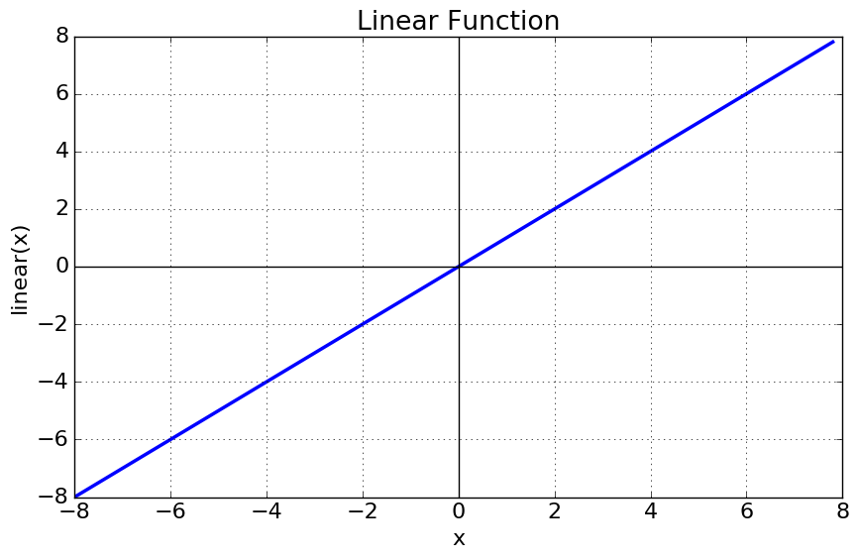
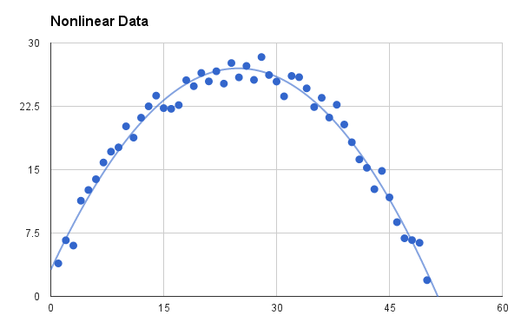


Activation Functions
https://towardsdatascience.com/activation-functions-neural-networks-1cbd9f8d91d6

Slide 13
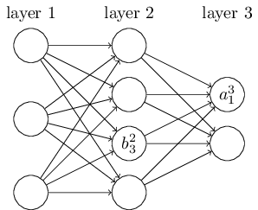
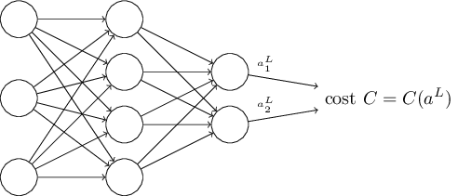
Back Propagation & Loss
https://towardsdatascience.com/a-step-by-step-implementation-of-gradient-descent-and-backpropagation-d58bda486110
http://neuralnetworksanddeeplearning.com/chap2.html

Slide 14
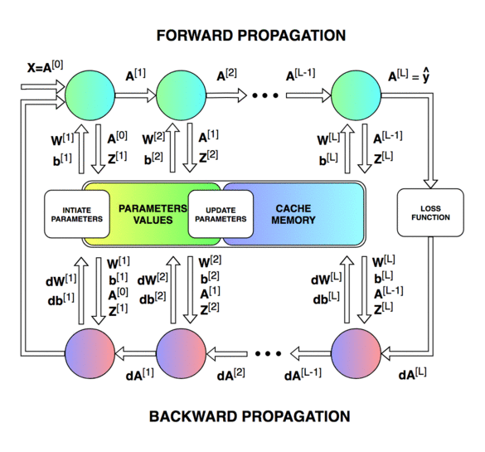
Back Propagation & Loss
https://medium.com/datathings/neural-networks-and-backpropagation-explained-in-a-simple-way-f540a3611f5e
Regression: Mean Squared Error Loss ;
Binary Classification : Binary Cross Entropy ;
Multiclass Classification: Categorical Cross Entropy
https://machinelearningmastery.com/how-to-choose-loss-functions-when-training-deep-learning-neural-networks/

Slide 15

Optimizers & Learning Rate
https://medium.com/datadriveninvestor/overview-of-different-optimizers-for-neural-networks-e0ed119440c3
https://www.jeremyjordan.me/nn-learning-rate/

Slide 16
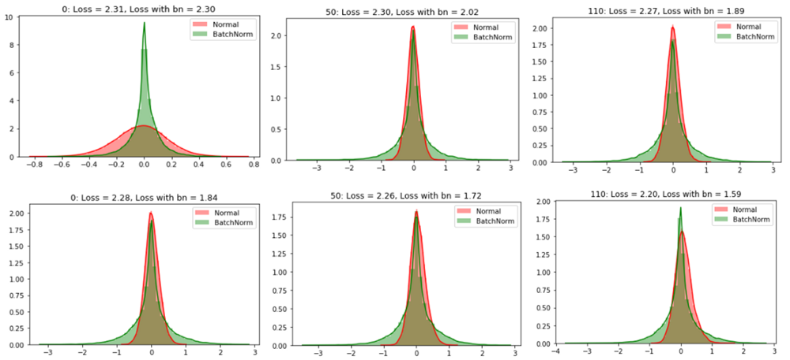
Batch Normalization
https://mc.ai/batch-normalization-and-dropout-in-neural-networks-explained-with-pytorch/
https://towardsdatascience.com/batch-normalization-in-neural-networks-1ac91516821c
https://www.youtube.com/watch?v=kK8-jCCR4is&feature=youtu.be

Slide 17
Courses and Certification
Follow Up
https://www.youtube.com/watch?v=G5b4jRBKNxw&list=PLZbbT5o_s2xq7LwI2y8_QtvuXZedL6tQU&index=25
In Depth Understanding:
https://www.coursera.org/specializations/deep-learning
To be continued …..

Slide 18
TensorFlow 2.0
Tensorflow 2.0 has made a lot of the older tutorials obsolete.
Keras is the standard interface now.
Below are the most up-to-date resources:
https://www.tensorflow.org/tutorials
https://www.youtube.com/watch?v=oFFbKogYdfc&list=PLQY2H8rRoyvwLbzbnKJ59NkZvQAW9wLbx&index=27

Slide 19

TensorFlow: Dataflow Graph
Node: Mathematical Operation
Edge: Multi-Dimensional Array
Build Graph
Run
Eval
Once graph is build
Loop to train
https://johncarlosbaez.wordpress.com/2016/06/05/programming-with-data-flow-graphs/

Slide 20
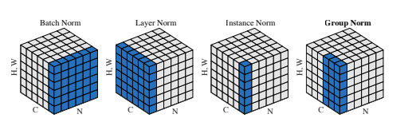
Different Normalization Techniques
Batch Normalization: activations in a network across a mini batch for each feature.
Weight Normalization: instead of activations, normalize weights of the layer. Separates magnitude and direction like a unit vector. Weight Normalization + mean-only batch normalization.
Layer Normalization: Normalizes the input across features
https://machinelearningmastery.com/how-to-improve-neural-network-stability-and-modeling-performance-with-data-scaling/
https://mlexplained.com/2018/11/30/an-overview-of-normalization-methods-in-deep-learning/

Slide 21
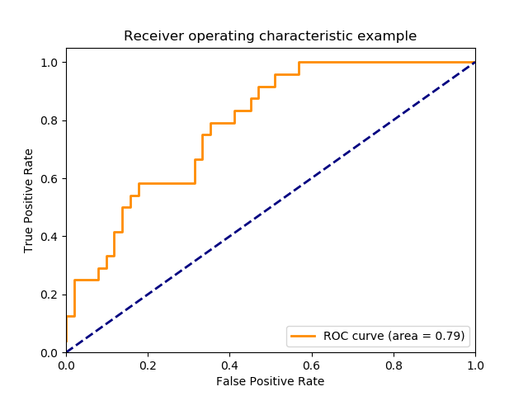
Metrics – Performance Measures Compare Algorithms
Classification
Classification Accuracy. Right or Wrong
Log Loss: Fuzzy (confidence in being right and in being wrong)
Area Under ROC Curve. (Binary Classification) : Ability to Discriminate ; Plot True Positive Rate and False Positive Rate at different thresholds
Confusion Matrix. True Positive False Positive
False Negative True Negative
Classification Report.
Precision ; Recall ; Fi Score
Precision = TP/TP+FP; Recall = TP/TP+FN ;
F1 Score = 2*(Recall * Precision) / (Recall + Precision)
When Wrong and right are not equally important
https://www.youtube.com/watch?v=4jRBRDbJemM

Slide 22
Metrics – Performance Measures Compare Algorithms
Regression Problems:
Mean Absolute Error
Mean Squared Error
R^2 Metric Correlation Based
Var(mean) – variation(predicted function)/var(mean) – if variation around a function is less than that around mean(random( - then the function is capturing some relation – the larger this gap the better the model.
https://machinelearningmastery.com/metrics-evaluate-machine-learning-algorithms-python/
https://towardsdatascience.com/metrics-to-evaluate-your-machine-learning-algorithm-f10ba6e38234
https://www.youtube.com/watch?v=2AQKmw14mHM

Slide 23
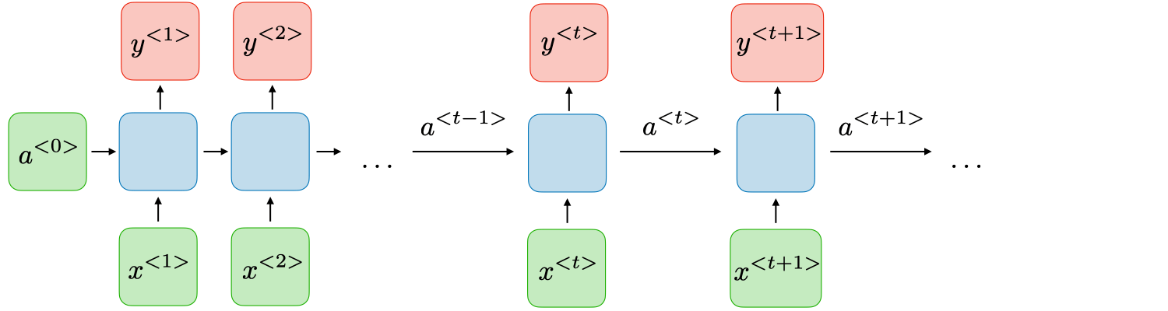
Recurrent Neural Network
RNN Cell = Layer = Time Step
https://stanford.edu/~shervine/teaching/cs-230/cheatsheet-recurrent-neural-networks
https://www.youtube.com/watch?v=esgbmJ6SnSY
https://www.youtube.com/watch?v=RrB605Mbpic

Slide 24
Vanishing and Exploding Gradients
More Layers ; More backpropagation : floating point numbers become smaller and smaller (Vanishing): Opposite happens to whole numbers they become larger and larger.(Exploding)
Problem more pronounced in RNNs
Initial layers are critical as they capture correlation between input data…
Due to vanishing gradients weights may not update and get stuck at zero… bad training !!
Relu activations preferred to sigmoid :helps in controlling gradients
Residual networks
https://towardsdatascience.com/the-vanishing-gradient-problem-69bf08b15484

Slide 25
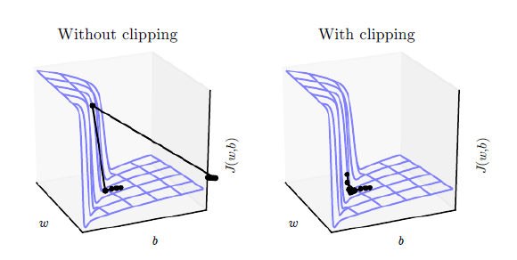
Gradient Clipping to avoid Exploding Gradients
https://medium.com/learn-love-ai/the-curious-case-of-the-vanishing-exploding-gradient-bf58ec6822eb

Slide 26
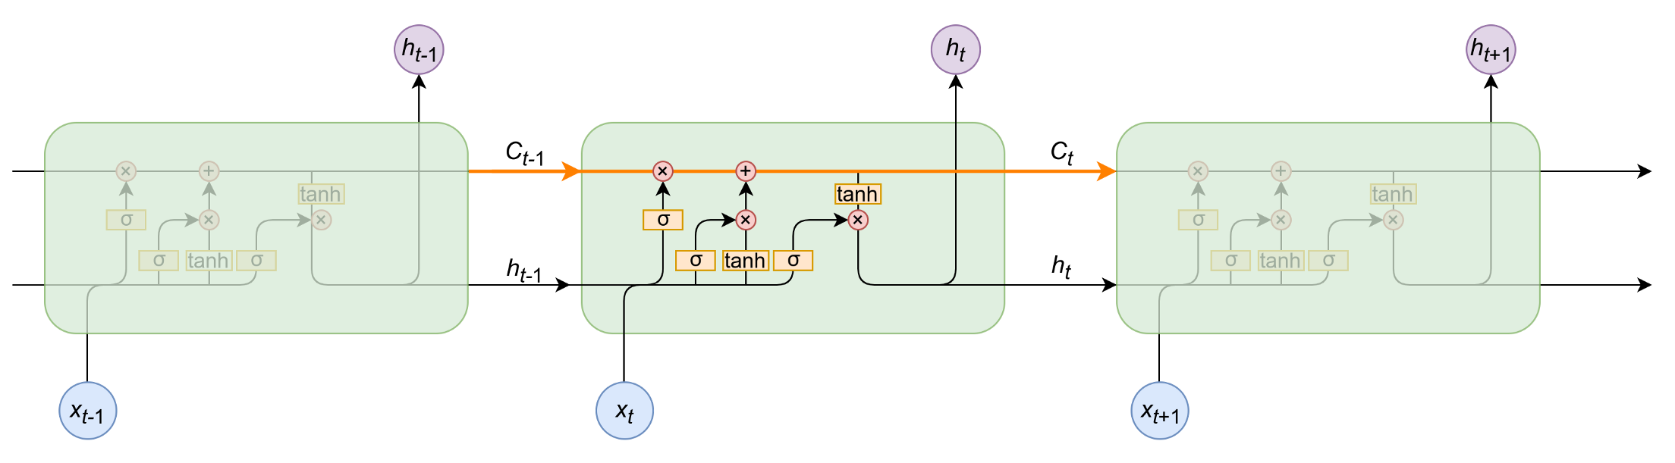
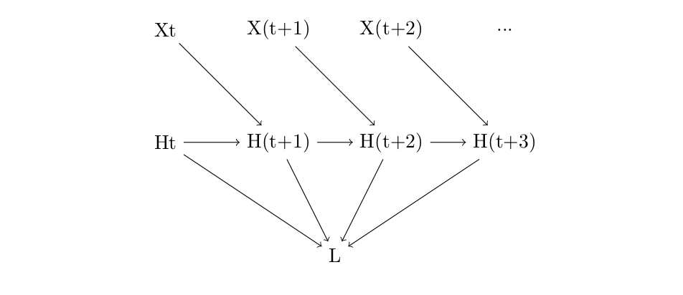
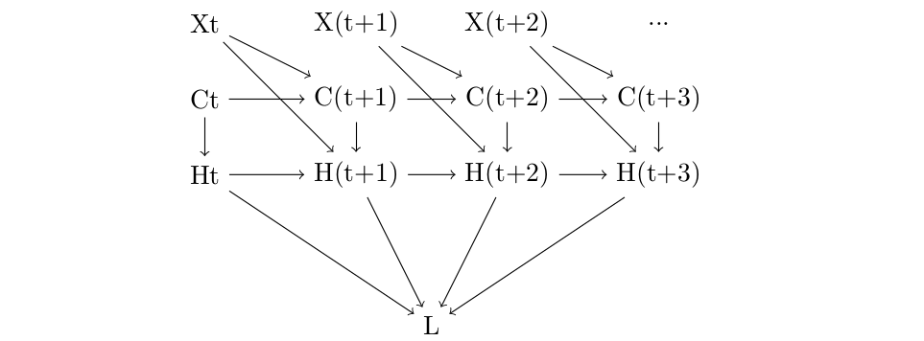
LSTM and Back Propagation
https://medium.com/@dovanhuyen2018/back-propagation-in-long-short-term-memory-lstm-a13ad8ae7a57
https://medium.com/learn-love-ai/step-by-step-walkthrough-of-rnn-training-part-ii-7141084d274b

Slide 27
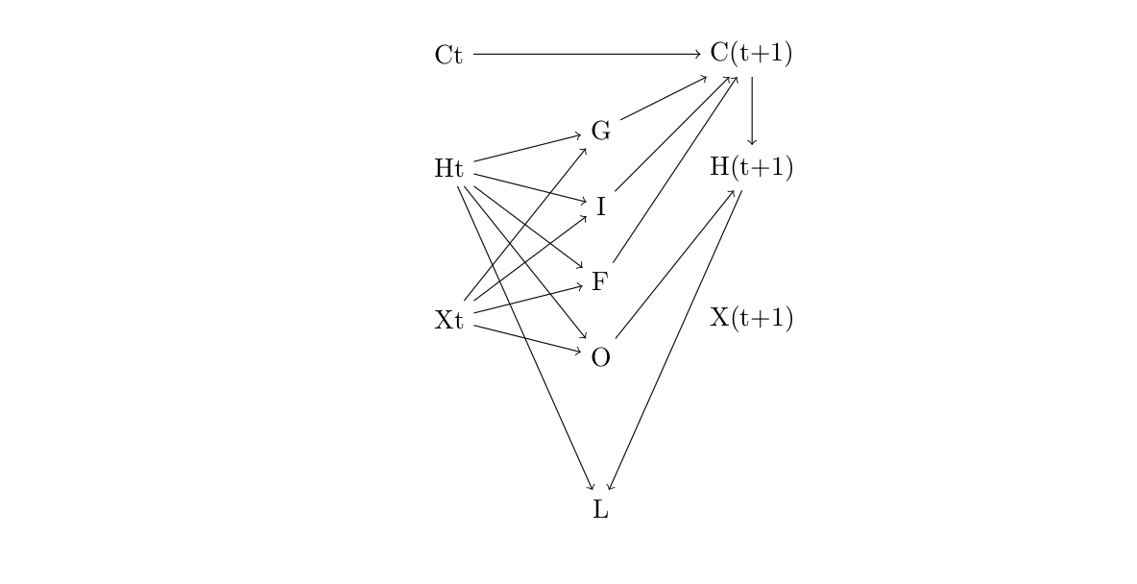
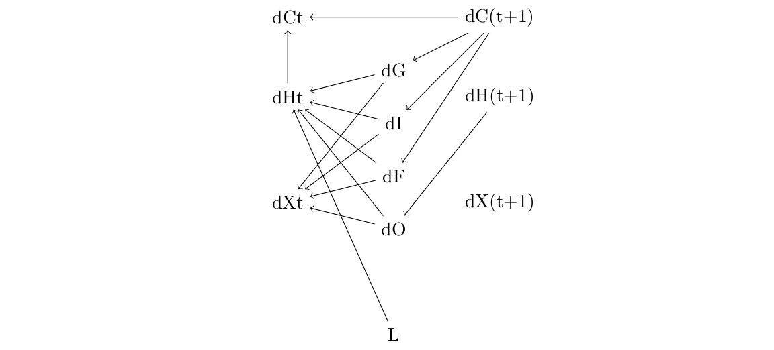
LSTM and Back Propagation
https://medium.com/@dovanhuyen2018/back-propagation-in-long-short-term-memory-lstm-a13ad8ae7a57

Slide 28
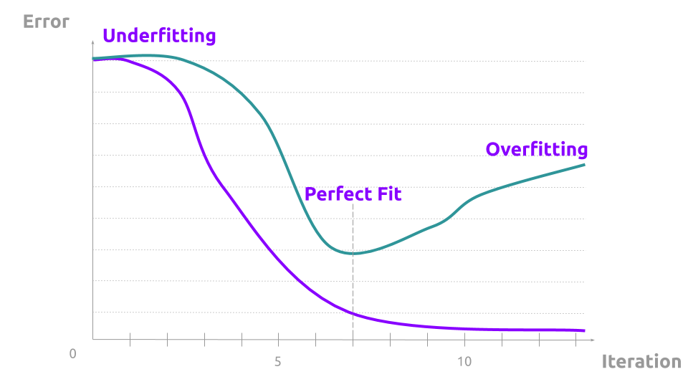
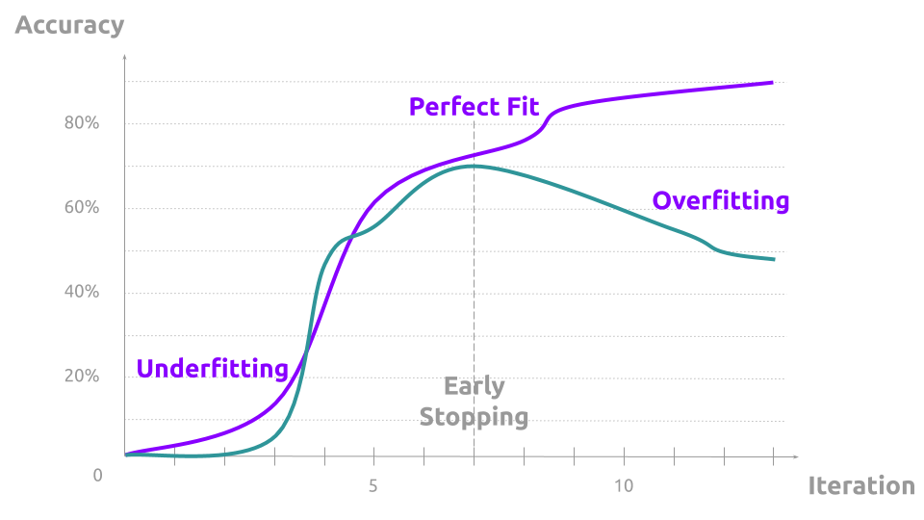
Generalization
https://towardsdatascience.com/overfitting-and-underfitting-visually-explained-like-youre-five-8a389b511751
https://colab.research.google.com/github/tensorflow/docs/blob/master/site/en/tutorials/keras/overfit_and_underfit.ipynb

Slide 29
Courses and Certification
Follow Up
https://www.youtube.com/watch?v=G5b4jRBKNxw&list=PLZbbT5o_s2xq7LwI2y8_QtvuXZedL6tQU&index=25
In Depth Understanding:
https://www.coursera.org/specializations/deep-learning
To be continued …..

Slide 30
PART 2
Natural Language Processing

Slide 31
Applications in NLP
Language Modeling
Language Translation
Question Answering
Sentiment Classification
Named Entity Recognition
Topic Labelling
Language Correction / Conditioning
Natural Language Generation

Slide 32
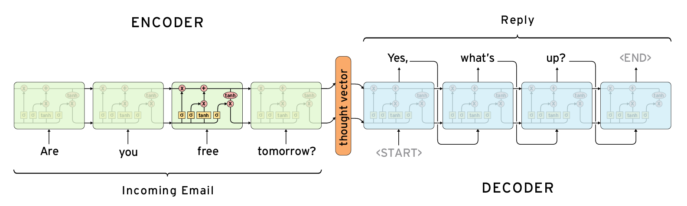
Sequence To Sequence Learning
http://jalammar.github.io/visualizing-neural-machine-translation-mechanics-of-seq2seq-models-with-attention/

Slide 33
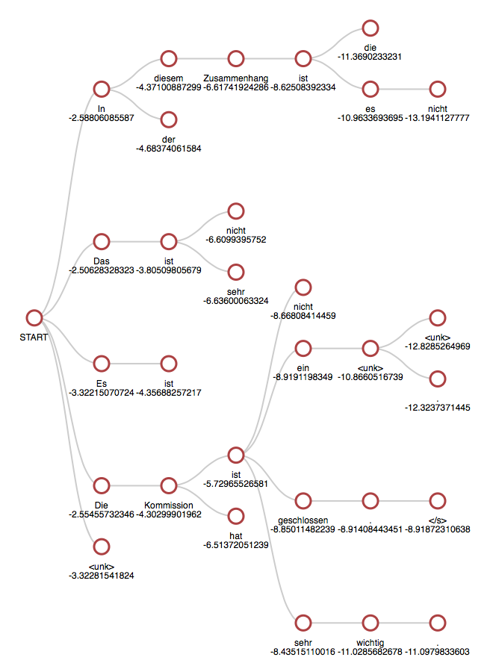
Fundamental Concept : Beam Search
https://machinelearningmastery.com/beam-search-decoder-natural-language-processing/
https://medium.com/the-artificial-impostor/implementing-beam-search-part-1-4f53482 https://medium.com/the-artificial-impostor/implementing-beam-search-part-2-5783edd110fadaabe

Slide 34
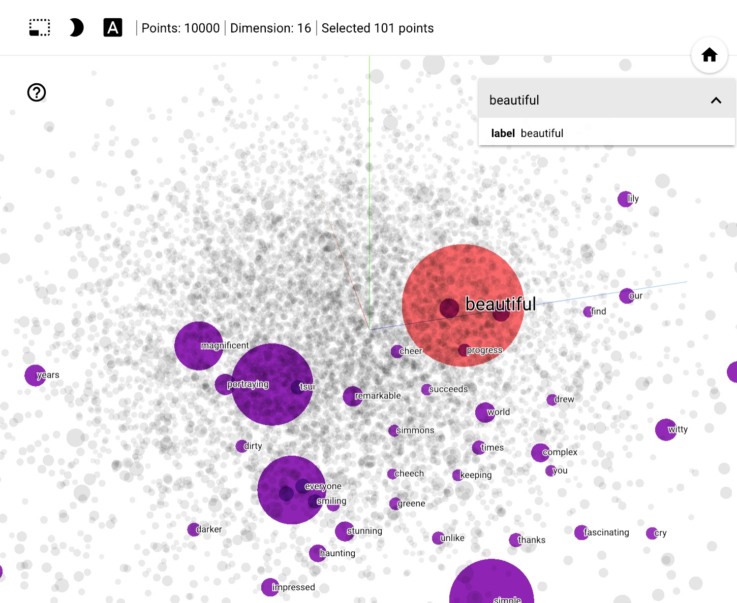
Word Embeddings
https://www.tensorflow.org/tutorials/text/word_embeddings

Slide 35
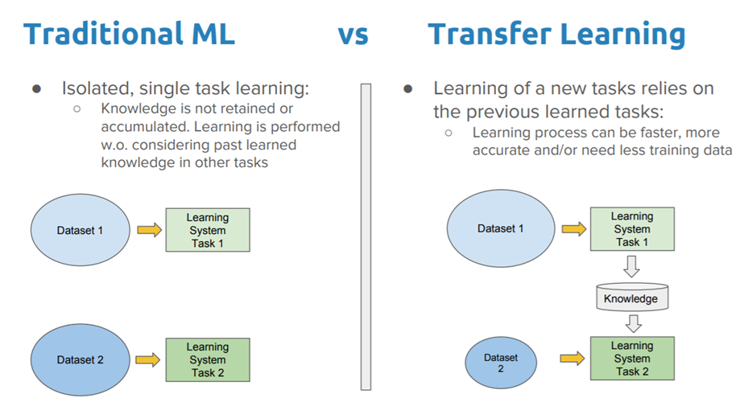
Transfer Learning
https://towardsdatascience.com/a-comprehensive-hands-on-guide-to-transfer-learning-with-real-world-applications-in-deep-learning-212bf3b2f27a

Slide 36
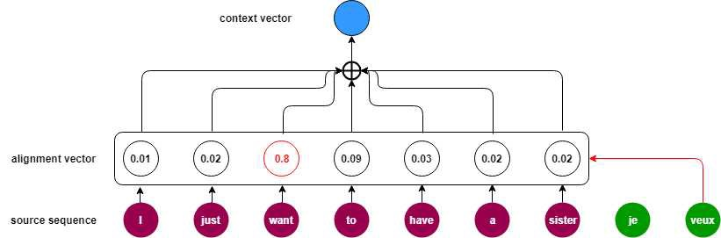
Attention Mechanism
https://medium.com/@b.terryjack/deep-learning-the-transformer-9ae5e9c5a190#:~:text=RNNs&text=The%20Encoders%20job%20is%20to,encoder%20RNN's%20final%20hidden%20state.&text=This%20context%20vector%20is%20the,the%20input%20text%2C%20etc).

Slide 37
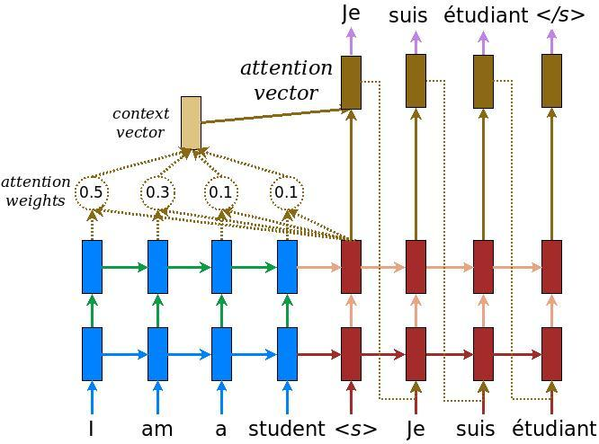
Neural Translation Models
https://www.tensorflow.org/tutorials/text/nmt_with_attention

Slide 38
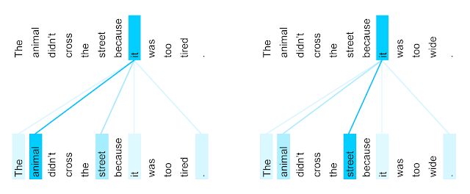
Transformers
https://medium.com/@b.terryjack/deep-learning-the-transformer-9ae5e9c5a190#:~:text=RNNs&text=The%20Encoders%20job%20is%20to,encoder%20RNN's%20final%20hidden%20state.&text=This%20context%20vector%20is%20the,the%20input%20text%2C%20etc).

Slide 39
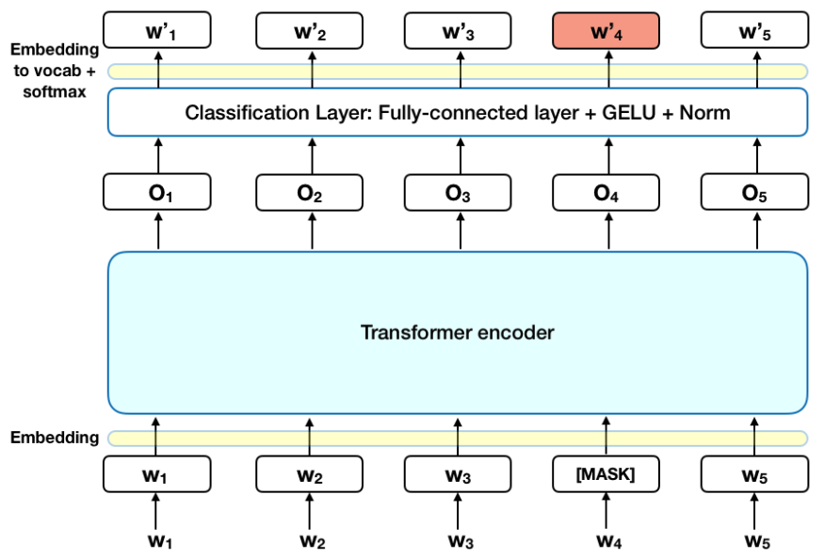
Language Modeling
https://talktotransformer.com/
https://gluon-nlp.mxnet.io/examples/language_model/language_model.html
http://jalammar.github.io/illustrated-gpt2/
https://towardsdatascience.com/bert-explained-state-of-the-art-language-model-for-nlp-f8b21a9b6270

Slide 40
Measurement and Benchmarking
BLEU
GLEU
Super GLUE Benchmark tests
https://towardsdatascience.com/evaluation-of-an-nlp-model-latest-benchmarks-90fd8ce6fae5
https://super.gluebenchmark.com/

Slide 41
Reading Open Source Codebases
https://github.com/google-research?q=bert&type=&language=
https://github.com/huggingface/transformers

Slide 42
Follow Up Work
Try to build a sentiment classifier
For Ideas
https://www.kaggle.com/shoheiazuma/tweet-sentiment-roberta-pytorch
https://www.analyticsvidhya.com/blog/2020/01/first-text-classification-in-pytorch/
https://www.curiousily.com/posts/sentiment-analysis-with-bert-and-hugging-face-using-pytorch-and-python/
We will discuss solutions and implementations next week.

Slide 43
Run Yourself!!
https://colab.research.google.com/drive/1PHv-IRLPCtv7oTcIGbsgZHqrB5LPvB7S#scrollTo=Tbodro8Fpmwr
https://youtu.be/8N-nM3QW7O0
https://www.tensorflow.org/tutorials/text/text_generation
https://colab.research.google.com/github/r9y9/Colaboratory/blob/master/DeepVoice3_multi_speaker_TTS_en_demo.ipynb\

Slide 44
Part 2
Computer Vision

Slide 45
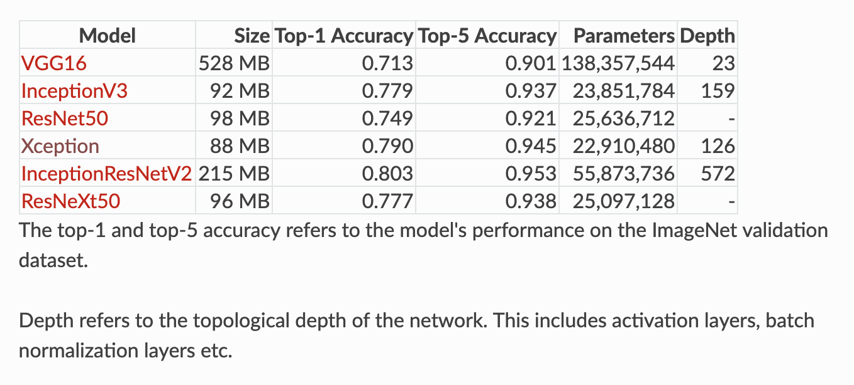
Transfer Learning
ImageNet (22,000 object categories -> 1000 categories; 1.2 million training images)
https://www.pyimagesearch.com/2017/03/20/imagenet-vggnet-resnet-inception-xception-keras/
https://towardsdatascience.com/illustrated-10-cnn-architectures-95d78ace614d

Slide 46
Meta Learning
learn to perform new tasks with minimal training (few-shot learning)
The Few-Shot Image Classification task
First, we need to define the N-way K-shot image classification task. Given:
a support set composed of N labels and, for each label, K labeled images;
a query set composed of Q query images;
https://towardsdatascience.com/one-shot-learning-with-siamese-networks-using-keras-17f34e75bb3d
https://www.sicara.ai/blog/2019-07-30-image-classification-few-shot-meta-learning
https://www.youtube.com/watch?v=ByeRnmHJ-uk
https://www.youtube.com/watch?v=NgTP8DV7_zs

Slide 47
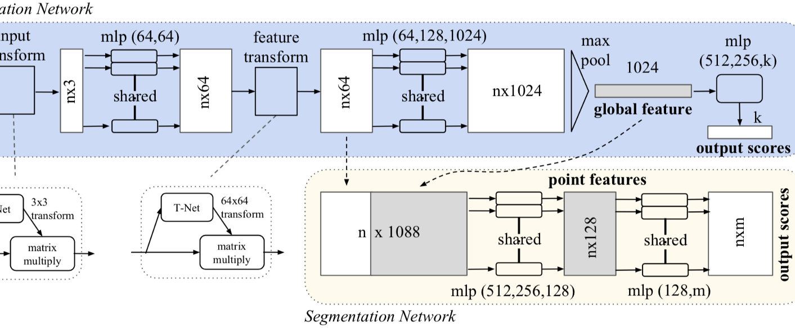
Point Net (3D Point Cloud)
https://arxiv.org/abs/1612.00593

Slide 48
Point Net Design Considerations
Permutation Invariance ( no order) – a collection of points relative to each other make an object or shape.
Symmetric Functions – Commutative functions like sum, average, max.
An aggregate signature of n input points.
Transformation Invariance – Geometric Invariance (rotation/scaling)
Pose Normalization / Spatial Transformation
U -> Localization Net (Regression NW)-> Theta -> Grid Generator -> V’
U , V’ ->Sampler - V

Slide 49
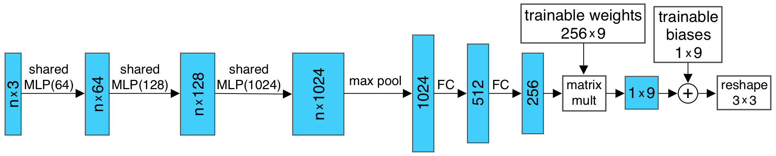
T-Net (POSE NORMALIZATION)
Independent embedding of each point
Geometric transformation -> matrix multiplication of each point with a transformation matrix
Regression NW – predicts an input-dependent 3by3 transformation matrix – matrix multiplied with nby3 input.
MLPs -> map i/p (independent+ identical) -> higher Dimensional space
Max Pool -> encode global feature vector -> reduced dims with FC layer
Combined with trainable params

Slide 50
Do Yourself!!
Video Processing
https://github.com/kenshohara/video-classification-3d-cnn-pytorch
https://www.analyticsvidhya.com/blog/2019/09/step-by-step-deep-learning-tutorial-video-classification-python/
https://www.pyimagesearch.com/2019/07/15/video-classification-with-keras-and-deep-learning/

Slide 51
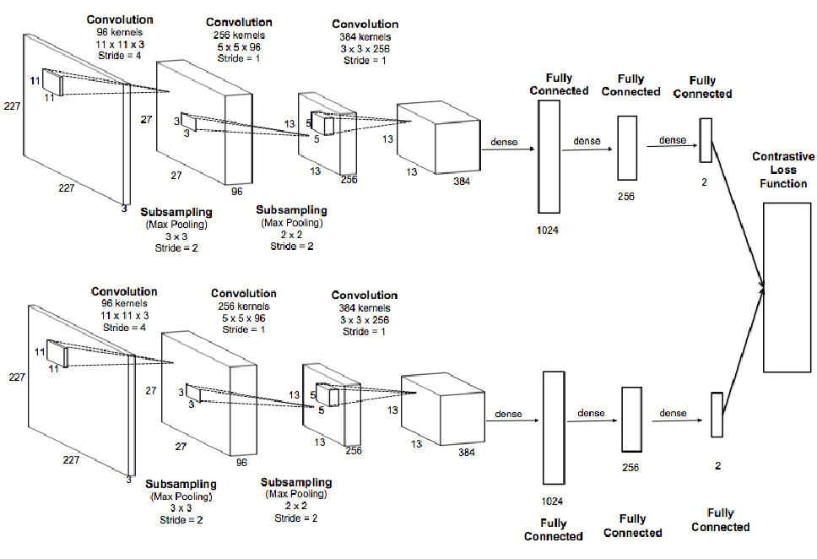
Siamese Network
http://papers.nips.cc/paper/769-signature-verification-using-a-siamese-time-delay-neural-network.pdf
https://medium.com/@reachraktim/object-tracking-with-siamese-networks-and-detectron2-572e04dac547

Slide 52
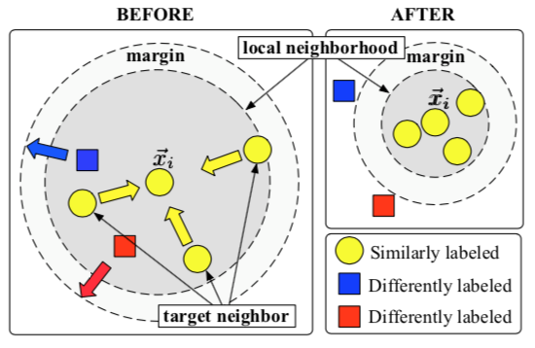
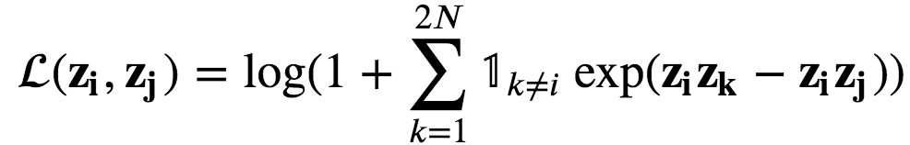
Contrastive Loss
Triplet loss (Weinberger et al. 2006)
https://towardsdatascience.com/contrasting-contrastive-loss-functions-3c13ca5f055e#:~:text=%20Types%20of%20contrastive%20loss%20functions%20%201,loss%20is%20a%20generalization%20of%20triplet...%20More%20
https://towardsdatascience.com/lossless-triplet-loss-7e932f990b24

Slide 53
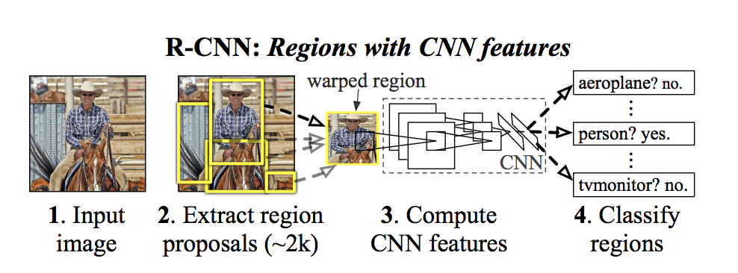
R-CNN
https://colab.research.google.com/github/mlvlab/COSE474/
blob/master/3_Object_Detection_and_MOT_tutorial.ipynb
https://towardsdatascience.com/r-cnn-fast-r-cnn-faster-r-cnn-yolo-object-detection-algorithms-36d53571365e

Slide 54
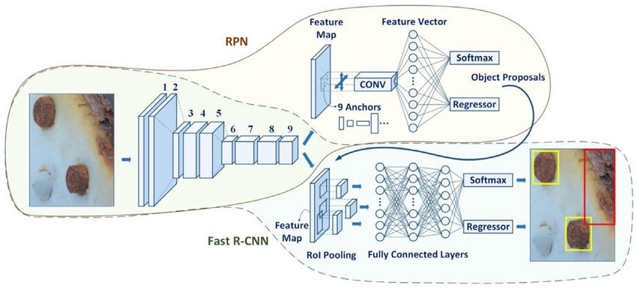
Faster R-CNN
https://colab.research.google.com/github/mlvlab/COSE474/blob/master/3_Object_Detection_and_MOT_tutorial.ipynb
https://towardsdatascience.com/faster-rcnn-object-detection-f865e5ed7fc4#:~:text=Faster%20RCNN%20is%20an%20object%20detection%20architecture%20presented,Shot%20Detector%29.%20Let%E2%80%99s%20explain%20how%20this%20architecture%20works%2C

Slide 55
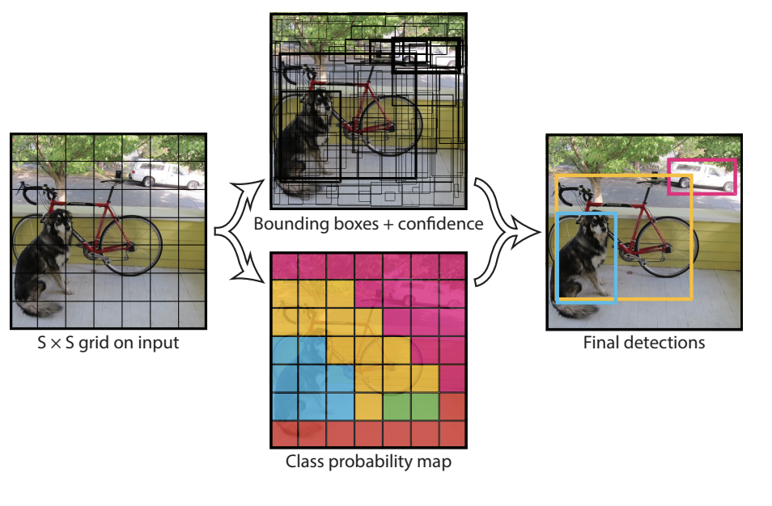
YOLO

Slide 56
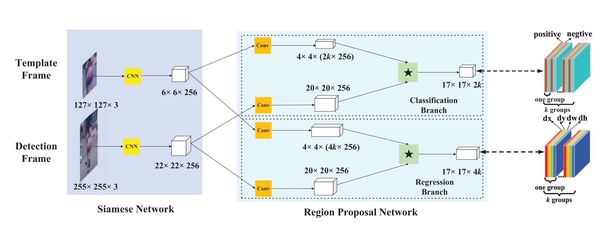
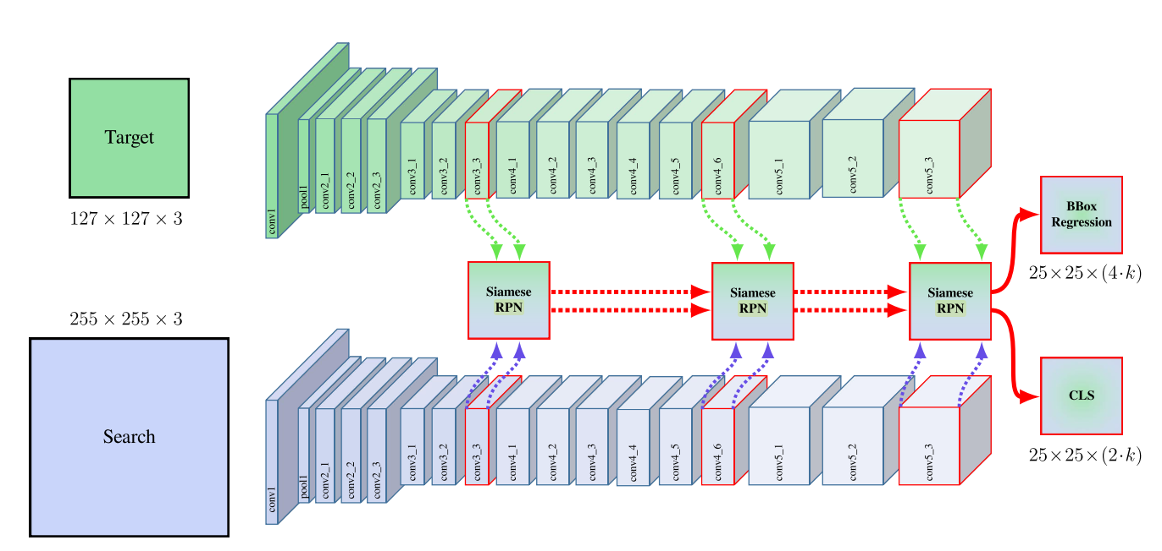
Object Detection and Tracking
SiamFC, SiamRPN, SiamRPN++, Detectron2
https://www.youtube.com/watch?v=oBklltKXtDE
https://medium.com/@reachraktim/object-tracking-with-siamese-networks-and-detectron2-572e04dac547

Slide 57
Resources
https://www.wandb.com/tutorial/transfer-learning
https://www.wandb.com/tutorial/one-shot-learning
https://github.com/lukas/ml-class/tree/master/videos
https://github.com/ultralytics/yolov3

Slide 58
Colabs
https://colab.research.google.com/github/tensorflow/hub/blob/master/examples/colab/object_detection.ipynb#scrollTo=lrUt_eWxBe1G
https://colab.research.google.com/github/mlvlab/COSE474/blob/master/3_Object_Detection_and_MOT_tutorial.ipynb#scrollTo=WnsyoUpmz42L
https://colab.research.google.com/drive/1ujJ9IV_64mq6VBuNkywUMCU_y7lHtqHD#scrollTo=sH3J9kx9bnPv
https://colab.research.google.com/github/vindruid/yolov3-in-colab/blob/master/yolov3_video.ipynb#scrollTo=47aetUx1Mm4I

Slide 59
Do Yourself!!
Face Recognition
https://hub.packtpub.com/face-recognition-using-siamese-networks-tutorial/
https://medium.com/predict/face-recognition-from-scratch-using-siamese-networks-and-tensorflow-df03e32f8cd0
https://github.com/shubham0204/Face_Recognition_with_TF

Slide 60
Part 2 Reinforcement Learning

Slide 61
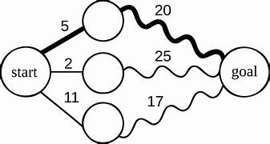
Dynamic Programming
https://en.wikipedia.org/wiki/Dynamic_programming
In both contexts it refers to simplifying a complicated problem by breaking it down into simpler sub-problems in a recursive manner. While some decision problems cannot be taken apart this way, decisions that span several points in time do often break apart recursively. Likewise, in computer science, if a problem can be solved optimally by breaking it into sub-problems and then recursively finding the optimal solutions to the sub-problems, then it is said to have optimal substructure.

Slide 62
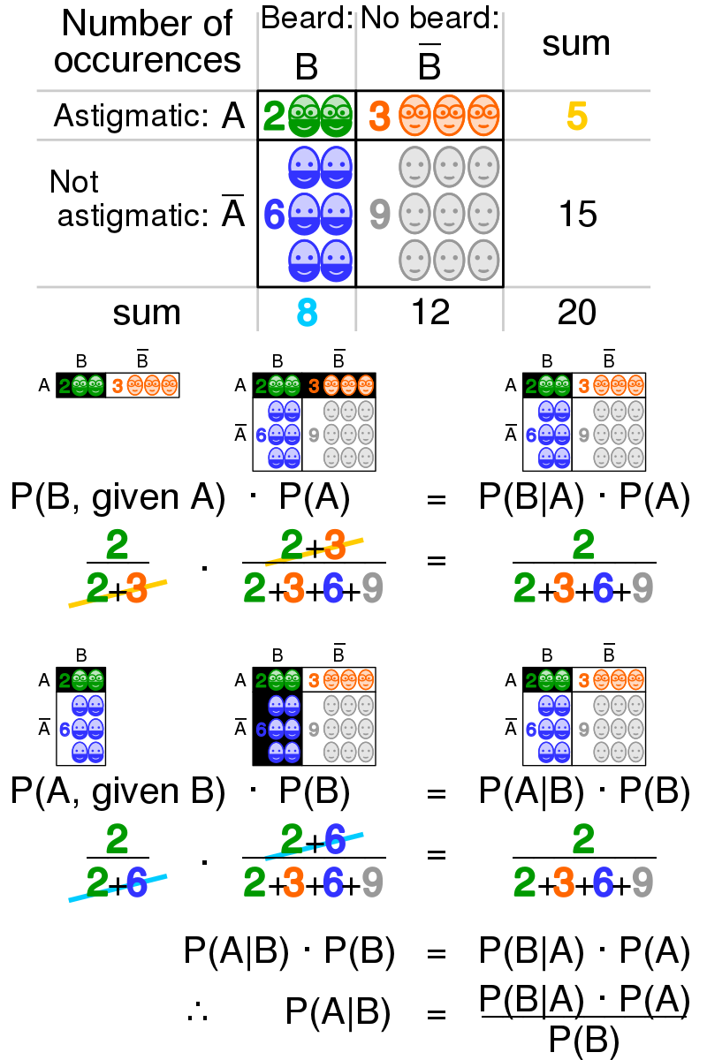
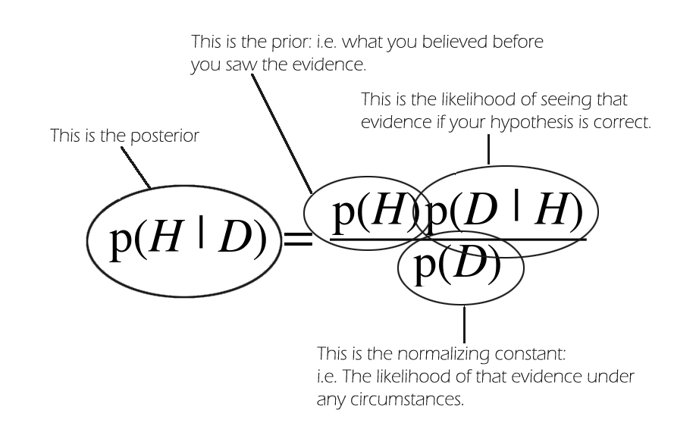
Bayes’ Theorem
https://en.wikipedia.org/wiki/Bayes%27_theorem

Slide 63
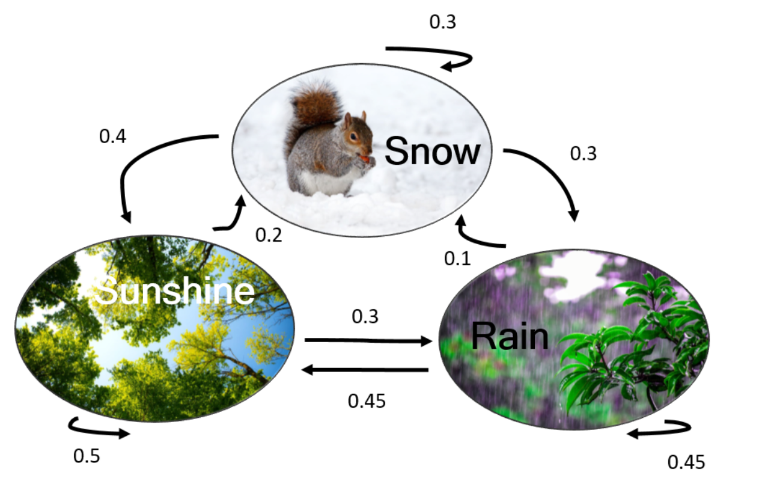
Hidden Markov Models
https://en.wikipedia.org/wiki/Hidden_Markov_model
Hidden Markov Model (HMM) is a statistical Markov model in which the system being modeled is assumed to be a Markov process – call it X – with unobservable ("hidden") states. HMM assumes that there is another process Y whose behavior "depends" X.
The goal is to learn about X by observing Y. HMM stipulates that, for each time instance n0 ,the conditional probability distribution ofYn0 given the history {Xn = xn}n<=n0 must NOT depend {xn}n<n0
https://towardsdatascience.com/introduction-to-hidden-markov-models-cd2c93e6b781
https://www.youtube.com/watch?v=J_y5hx_ySCg&list=PLix7MmR3doRo3NGNzrq48FItR3TDyuLCo
Non Markov Models: ARMA (Autoregressive-moving-average)

Slide 64
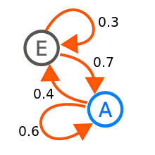
Monte Carlo Markov Chain
Markov processes are the basis for general stochastic simulation methods known as Markov chain Monte Carlo, which are used for simulating sampling from complex probability distributions, and have found application in Bayesian statistics and artificial intelligence.
Markov Chain Monte Carlo (MCMC) methods are a class of algorithms for sampling from a probability distribution based on constructing a Markov chain that has the desired distribution as its stationary distribution. The state of the chain after a number of steps is then used as a sample of the desired distribution. The quality of the sample improves as a function of the number of steps.
Markov Chain
https://en.wikipedia.org/wiki/Markov_chain_Monte_Carlo
MCMC methods are used to approximate the posterior distribution of a parameter of interest by random sampling in a probabilistic space.
Everything is a random variable: X, u, var - everything depends on sampling
https://towardsdatascience.com/a-zero-math-introduction-to-markov-chain-monte-carlo-methods-dcba889e0c50
https://towardsdatascience.com/mcmc-intuition-for-everyone-5ae79fff22b1

Slide 65
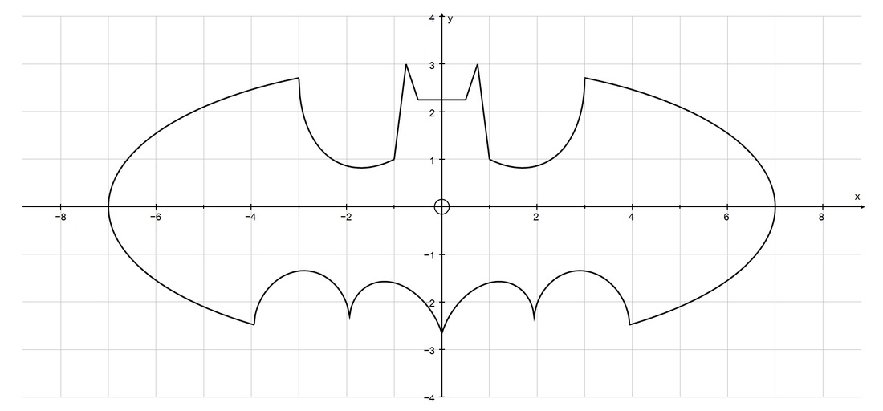
Monte Carlo Methods
Any method which solves a problem by generating suitable random numbers, and observing that fraction of numbers obeying some property or properties, can be classified as a Monte Carlo method
MCMC methods allow us to estimate the shape of a posterior distribution in case we can’t compute it directly.
The Monte Carlo method for reinforcement learning learns directly from episodes of experience without any prior knowledge of MDP transitions. Here, the random component is the return or reward.
it can only be applied to episodic MDPs.
The episode has to terminate before we can calculate any returns.
The value is the mean return of all sample trajectories for each state in an episode.
https://towardsdatascience.com/a-zero-math-introduction-to-markov-chain-monte-carlo-methods-dcba889e0c50
https://www.analyticsvidhya.com/blog/2018/11/reinforcement-learning-introduction-monte-carlo-learning-openai-gym/

Slide 66
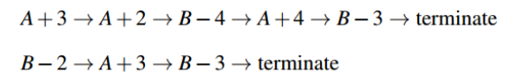
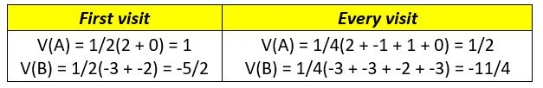
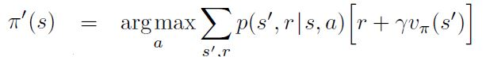
Monte Carlo Reinforcement Learning
Monte Carlo Policy Evaluation
Initialize the policy, state-value function
Start by generating an episode according to the current policy
Keep track of the states encountered through that episode
Select a state in 2.1
A. Add to a list the return received after first occurrence of this state. (First Visit Monte Carlo)
B. Add to a list the return received after every occurrence of this state.
(Every Visit Monte Carlo)
Average over all returns
Set the value of the state as that computed average
Repeat step 3
Repeat 2-4 until satisfied
V(S_{t}) ← V(S_{t}) + α (G_{t} − V(S_{t}))
Monte Carlo Control (Dynamic Programming)
Do not know the state transition probabilities p(s’,r/s,a), we can’t do a look-ahead search like DP. All the information is obtained via experience of playing the game or exploring the environment.
Policy improvement is done by making the policy greedy with respect to the current value function.
https://www.analyticsvidhya.com/blog/2018/11/reinforcement-learning-introduction-monte-carlo-learning-openai-gym/

Slide 67
Temporal Difference Reinforcement Learning
Q-Learning
SARSA - State-Action-Reward-State-Action
DQN - Deep Q Network
DDPG - Deep Deterministic Policy Gradient
Actor – Critic Method
….
https://towardsdatascience.com/introduction-to-various-reinforcement-learning-algorithms-i-q-learning-sarsa-dqn-ddpg-72a5e0cb6287

Slide 68








Q Learning
Estimated/Expected Return
Discounted Return
Bellman Optimality Equation
Exploration vs Exploitation
https://deeplizard.com/learn/video/nyjbcRQ-uQ8

Slide 69


Explore Exploit Dilemma
Epsilon Greedy
Optimistic Initial Values
Upper Confidence Bound – UCB
Thompson Sampling (Bayesian)
https://www.geeksforgeeks.org/upper-confidence-bound-algorithm-in-reinforcement-learning/
https://en.wikipedia.org/wiki/Thompson_sampling

Slide 70

Deep Q Learning
MLP / CNN
Experience Replay
Target NW

Slide 71

Value Based Methods vs Policy Based Methods
In policy iteration algorithms, you start with a random policy, then find the value function of that policy (policy evaluation step), then find a new (improved) policy based on the previous value function, and so on. In this process, each policy is guaranteed to be a strict improvement over the previous one (unless it is already optimal). Given a policy, its value function can be obtained using the Bellman operator.
In value iteration, you start with a random value function and then find a new (improved) value function in an iterative process, until reaching the optimal value function. Notice that you can derive easily the optimal policy from the optimal value function. This process is based on the optimality Bellman operator.
https://towardsdatascience.com/an-overview-of-classic-reinforcement-learning-algorithms-part-1-f79c8b87e5af
https://www.youtube.com/watch?v=bvRO3BYUl44
http://incompleteideas.net/book/ebook/node46.html

Slide 72

REINFORCE
https://towardsdatascience.com/learning-reinforcement-learning-reinforce-with-pytorch-5e8ad7fc7da0

Slide 73

Actor Critic
https://www.youtube.com/watch?v=2vJtbAha3To

Slide 74

DDPG

Slide 75

Proximal Policy Optimization
it formalizes the constraint as a penalty in the objective function
Policy gradient is mainly an on-policy method. It searches actions from the current state. Hence, resuming the exploration from a bad state with a locally bad policy hurts performance badly.
Trust region
Determine the maximum step size that we want to explore first . Then we locate the optimal point within the trust region and resume the search from there. In order not to make bad decisions, we can shrink the trust region if the policy is changing too much.
limit how far we can change our policy in each iteration through the KL-divergence. KL-divergence measures the difference between two data distributions p and q.
https://medium.com/@jonathan_hui/rl-proximal-policy-optimization-ppo-explained-77f014ec3f12
https://www.youtube.com/watch?v=5P7I-xPq8u8

Slide 76
PPO with Adaptive KL Penalty

Slide 77


PPO with Clipped Objective

Slide 78
Do Yourself!!
https://github.com/lazyprogrammer/machine_learning_examples.git
https://colab.research.google.com/github/Hvass-Labs/TensorFlow-Tutorials/blob/master/16_Reinforcement_Learning.ipynb#scrollTo=V2clLxry-3Gg
Tutorials and Courses
https://www.udemy.com/course/deep-reinforcement-learning-in-python/
https://deeplizard.com/learn/video/nyjbcRQ-uQ8

Slide 79
Tutorials
MCMC TUTORIAL
https://www.youtube.com/watch?v=9M_KPXwnrlE&list=PLQVvvaa0QuDdhOnp-FnVStDsALpYk2hk0
Do Yourself !!
https://www.toptal.com/deep-learning/pytorch-reinforcement-learning-tutorial
https://www.freecodecamp.org/news/an-introduction-to-deep-q-learning-lets-play-doom-54d02d8017d8/
Certification
https://www.coursera.org/specializations/reinforcement-learning
https://www.udacity.com/course/reinforcement-learning--ud600

Slide 80
Part 2 Imitation Learning

Slide 81


Slide 82

Generative Adversarial Networks
Minimax GAN Loss
min max(D, G)
optimal negative loss of the binary classifier problem of distinguishing between state-action pairs of agent and expert policy.
discriminator: maximize log D(x) + log(1 – D(G(z)))
generator: minimize log(1 – D(G(z)))
https://towardsdatascience.com/generative-adversarial-networks-gans-a-beginners-guide-f37c9f3b7817
https://www.youtube.com/watch?v=8L11aMN5KY8
https://colab.research.google.com/github/tensorflow/gan/blob/master/tensorflow_gan/examples/colab_notebooks/tfgan_tutorial.ipynb?utm_source=ss-gan&utm_campaign=colab-external&utm_medium=referral&utm_content=tfgan-intro#scrollTo=AH6gcvcwHvSn
https://machinelearningmastery.com/generative-adversarial-network-loss-functions/#:~:text=%20Standard%20GAN%20Loss%20Functions%20%201%20Discriminator,to%20the%20generator%20loss%20to%20overcome...%20More%20

Slide 83

Imitation Learning Fundamentals
Behavioral cloning (BC)
Behavioral cloning learns a policy as a supervised learning problem over state-action pairs from expert trajectories.
only tends to succeed with large amounts of training data and is not efficient due to compounding error caused by covariant shifts
One wrong move has irreparable damage.
Inverse reinforcement learning (IRL)
IRL learns a cost function - which explains the expert behavior but doesn’t directly tell the learner how to act
IRL finds a cost function under which the expert is uniquely optimal, and is based upon cost and not the policies
expensive to run, as it is learning reinforcement leaning in an inner loop
can diverge for locally optimal RL cost
https://medium.com/@SmartLabAI/a-brief-overview-of-imitation-learning-8a8a75c44a9c

Slide 84



Inverse RL
https://www.cell.com/trends/cognitive-sciences/fulltext/S1364-6613(19)30061-0
https://towardsdatascience.com/inverse-reinforcement-learning-6453b7cdc90d

Slide 85


Maximum Casual entropy IRL
Maximum casual entropy fits a cost function from a family of functions C with the optimization problem, which has high entropy and minimum cumulative cost.
H(π) is the γ-discounted causal entropy of the policy π
Similar to distributions of policies, many different distributions of paths match feature counts when any demonstrated behavior is sub-optimal. Any one distribution from among this set may exhibit a preference for some of the paths over others that is not implied by the path features. We employ the principle of maximum entropy, which resolves this ambiguity by choosing the distribution that does not exhibit any additional preferences beyond matching feature expectations (Equation 1). The resulting distribution over paths for deterministic MDPs is parameterized by reward weights θ (Equation 2). Under this model, plans with equivalent rewards have equal probabilities, and plans with higher rewards are exponentially more preferred.
https://www.aaai.org/Papers/AAAI/2008/AAAI08-227.pdf

Slide 86


Apprenticeship Learning
the goal is to find the policy performing better than the expert.
The algorithm alternates between sampling trajectories for the policy by simulating the environment and then optimizing the policy.
Allows the apprenticeship learning to succeed, which requires a convex space created as the convex hull over a linear combination of basic functions.
The basic functions are taken as the cost function that results from maximizing over the sampled points. – Linear Cost Functions
Problems:
1. Craft features very carefully : Unless the true cost function lies in C, there is no guarantee that AL will recover
the expert policy.
2. Careful tuning of the sampling procedure.
https://ai.stanford.edu/~ang/papers/icml04-apprentice.pdf

Slide 87

GENERATIVE ADVERSARIAL IMITATION LEARNING
GAIL is a model-free imitation learning algorithm that obtains significant performance gains over model-free methods in imitating complex behaviors in large, high-dimensional environments.
GAIL removed the need of this tuning by using a GAN to tune the sampling procedure.
linear cost function with predefined set of features are too simple.
A more complex class of cost functions - Neural Network
The solution to the primal RL problem is optimal - the same solution as the solution recovered from the IRL cost function.
Regularized Inverse RL implicitly seeks a policy whose occupancy measure is close to the expert’s.
Rho – occupancy measure – distribution of state-action pair
Psi* – experts’ occupancy measure
https://medium.com/@sanketgujar95/generative-adversarial-imitation-learning-266f45634e60
https://github.com/nav74neet/gail_gym
https://github.com/Techget/gail-tf-sc2
https://github.com/bukysun/gail-traj-eb

Slide 88
GENERATIVE ADVERSARIAL IMITATION LEARNING
As constant regularizer leads to exact matching occupancy measures, but also the indicator regularizer is incapable of exactly matching occupancy measures
Tractable in large environments.
Optimal Loss ~ Jenson Shannon Divergence
Entropy H – policy regularizer controlled by lambda>=0
Need to find a policy whose occupancy measure minimizes Jensen-Shannon divergence to the expert policy.
Find a saddle point of the above expression.
Empirical Cost Regulizer
The regularizer places low penalty on cost function c that assigns an amount of negative cost to the expert-action pairs. it is an average over expert data, and therefore can adjust to arbitrary expert datasets
Convex conjugate of the above regularizer can be defined as

Slide 89

GENERATIVE ADVERSARIAL IMITATION LEARNING
The learner’s occupancy measure will be analogous to the data generated by G, and the expert’s occupancy measure is analogous to the true data distribution. The discriminator function can be interpreted as a local cost function providing learning signals to the policy.
We are basically going to find an agent policy π as well as the discriminator (D) to try to discriminate if the state and action pair are generated by the expert or by the policy.
Gradient descent over policy and discriminator parameters. Policy gradient guarantees to converge to a local minima and is model free. But gradient estimates can have a high variance and also small steps are required for policy gradient
TRPO - prevents the policy from changing too much due to noise in policy gradients
Fit a parameterized policy (π) and a discriminator network with weights and alternate between an Adam gradient steps to increase value with respect to D, and a TRPO step on θ to decrease the value with respect to policy(π).
GAIL is not sample efficient in terms of environment interactions during training.

Slide 90

GENERATIVE ADVERSARIAL IMITATION LEARNING
Schematic diagram of the GAIL algorithm ( s l n denotes the detected symbol vector of the nth subgroup for the lth candidate in the deterministic grouping iteration, and s l I denotes the detected symbol vector of the selected D symbols for the lth candidate in the index selection iteration). - Low-complexity Group Alternate Iterative List Detection for MIMO Systems
Games, Robotics, Trading, Language Labeling - Explicit human decision processes’ data available
https://medium.com/@jonathan_hui/rl-trust-region-policy-optimization-trpo-explained-a6ee04eeeee9

Slide 91
Self Imitation Learning
- a replay memory that collects experience from the original actor-critic on-policy memory
- an off-policy training loop that runs after the actor-critic on-policy training loop
- an imitation-learning loss which can be thought of as a clipped advantage: max(returns - predicted value, 0)
The clip is so that if an action actually produces a better-than-expected value, it should be used for training, hence the self-imitation since it is learning from its own good samples.
The actor’s policy loss is simply the log-prob times that clipped advantage, and the critic’s value loss is just the mean-squared loss of the clipped advantage.
SIL addresses the major problem of exploiting previous good explorations, by learning from them more using off-policy training.
Showing that A2C+SIL does a good job on hard exploration games as well as improves overall performance
https://github.com/TianhongDai/self-imitation-learning-pytorch
https://yobibyte.github.io/files/paper_notes/sil.pdf

Slide 92

Self Imitation Learning
SIL flow:
• Play an episode till the end and store the experiences
• Recalculate the return and store it in the experience replay instead of reward
• Do an A2C update on the on-policy samples
• Do several minibatch updates on the prioritized samples from memory
replay with the SIL objective
sample interesting trajectories which have higher clipped advantages

Slide 93

Self Imitation Learning
https://medium.com/intelligentunit/paper-notes-2-self-imitation-learning-b3a0fbdee351

Slide 94
Imitation Learning Examples and Repos
https://github.com/andrewliao11/gail-tf.git
https://github.com/TianhongDai/self-imitation-learning-pytorch.git
https://github.com/Techget/gail-tf-sc2
https://github.com/nav74neet/gail_gym
https://github.com/kengz/SLM-Lab

Slide 95
Further Reading
https://bcourses.berkeley.edu/courses/1453965/files/69855652/download?verifier=5DYZT6niDXA1pc4fTuIndZ1tpIsJeCmcicRgcpY2&wrap=1
https://www.andrew.cmu.edu/course/10-403/slides/S19_lecture2_behaviorcloning.pdf
https://medium.com/@marksaroufim/building-your-own-game-simulations-for-reinforcement-learning-with-unity-ml-agents-a-code-deep-e69a7bbc601e - Setup Unity

Slide 96


Deep Q-Learning from Demonstrations
https://danieltakeshi.github.io/2019/04/30/il-and-rl/
https://medium.com/@dohyeongkim/deep-q-learning-from-demonstrations-dqfd-for-minecraft-tutorial-1-4b462a18de5a
https://github.com/kimbring2/DQFD_Minecraft/blob/master/dqfd_treechop.py

Slide 97

Deep Q-Learning from Demonstrations
In Phase I, the agent does not do any exploration. Using the demonstration data, it performs gradient descent to minimize J(Q)J(Q). DQfD, like DQN, uses an experience replay buffer which stores the demonstration data. This means DQfD is off-policy as the data comes from the demonstrator, not the agent’s current behavioral policy.
In Phase II: the agent explores in the environment to collect its own data.DQfD follows an ϵϵ-greedy policy but keeps ϵ=0.01ϵ=0.01, so effectively there is no exploration and the only reason for “0.01” is to ensure that the agent cannot get stuck in the Atari environments. Key to this phase is that the agent still makes use of the demonstration data. That is, the demonstration data does not go away, and is still occasionally sampled with prioritization along with the new self-generated data. Each minibatch may therefore consist of a mix of demonstration and self-generated data, and these are used for gradient updates to minimize the same loss function J(Q)J(Q).
https://github.com/AurelianTactics/dqfd-with-keras

Slide 98
TF Agents and ML Agents on Colab
https://colab.research.google.com/drive/1Qg6E5kmf9n4G8rc5lXHIM_cQzMUFGH-g#forceEdit=true&sandboxMode=true
https://colab.research.google.com/drive/1nkOztXzU91MHEbuQ1T9GnynYdL_LRsHG#forceEdit=true&sandboxMode=true
https://colab.research.google.com/drive/1-g7CwEpk9nJ7SgWXfoCUf8pSLUW1b48i#scrollTo=pbVXrmEsLXDt&forceEdit=true&sandboxMode=true
https://colab.research.google.com/drive/13Q3nTOJY9vYbhg1C0aXXIVM-IQaVVSaU#scrollTo=m5VBnuZbLQtC
https://colab.research.google.com/github/Stable-Baselines-Team/rl-colab-notebooks/blob/master/stable_baselines_getting_started.ipynb
https://colab.research.google.com/github/tensorflow/agents/blob/master/docs/tutorials/1_dqn_tutorial.ipynb#scrollTo=cKOCZlhUgXVK

Slide 99

Unity3D Learn
https://learn.unity.com/
https://unity3d.com/machine-learning

Slide 100
Follow - UP
https://learn.unity.com/course/ml-agents-hummingbirds

Slide 101
PART 3
Projects

Slide 102
MASK DETECTION
https://www.aicrowd.com/challenges/mask-detection-challenge
Useful Links
https://www.pyimagesearch.com/2020/05/04/covid-19-face-mask-detector-with-opencv-keras-tensorflow-and-deep-learning/
https://heartbeat.fritz.ai/the-5-computer-vision-techniques-that-will-change-how-you-see-the-world-1ee19334354b
https://machinelearningmastery.com/how-to-perform-face-detection-with-classical-and-deep-learning-methods-in-python-with-keras/
https://towardsdatascience.com/real-time-face-recognition-an-end-to-end-project-b738bb0f7348
https://towardsdatascience.com/one-shot-learning-face-recognition-using-siamese-neural-network-a13dcf739e
https://medium.com/sciforce/robust-image-classification-with-a-small-data-set-be4de9897495
https://github.com/davisking/dlib/tree/master/python_examples
https://github.com/TianxingWu/realtime-glasses-detection

Slide 103
GOOGLE LANDMARK RECOGNITION
https://www.kaggle.com/c/landmark-recognition-2020/overview/evaluation
http://www.cs.cmu.edu/~takeuchi/iuw97/iuw97.html
https://static.googleusercontent.com/media/www.google.com/en//googleblogs/pdfs/google_landmark_recognition.pdf
https://arxiv.org/pdf/1908.10192.pdf

Slide 104
NLP with Disaster Tweet
https://www.kaggle.com/c/nlp-getting-started
https://engineering.tableau.com/overcoming-ambiguity-in-natural-language-the-research-behind-ask-data-d5983de5257f
https://towardsdatascience.com/named-entity-disambiguation-boosted-with-knowledge-graphs-4a93a94381ef

Slide 105
Natural Language Inference
https://www.aicrowd.com/challenges/mediqa-2019-natural-language-inference-nli
https://towardsdatascience.com/convolutional-attention-model-for-natural-language-inference-a754834c0d83
https://www.aclweb.org/anthology/C08-3008.pdf
https://arxiv.org/pdf/1901.08079.pdf
https://europepmc.org/article/med/28269825

Slide 106
OBSTACLE NAVIGATION RL PROBLEM
https://www.aicrowd.com/challenges/unity-obstacle-tower-challenge
https://unity3d.com/how-to/unity-machine-learning-agents
https://arxiv.org/pdf/1902.01378.pdf

Slide 107
Google Cloud Resources
Training and Deployment of AI services

Slide 108
GCP Resources
Google Cloud Learning Hub
Google Cloud Next
https://inthecloud.withgoogle.com/next-onair-learning/home.html?utm_source=google&utm_medium=blog&utm_content=build-your-cloud-skills
https://cloud.withgoogle.com/next/sf/

Slide 109
Google Cloud Learning Resources
https://cloud.google.com/training/badges?utm_source=google&utm_medium=blog&utm_content=build-your-cloud-skills
https://google.qwiklabs.com/quests/136?utm_source=google&utm_medium=lp&utm_campaign=gcpskills
https://cloud.google.com/blog/topics/training-certifications/build-your-cloud-skills-at-next20-onair-no-cost-training-opportunities

Slide 110
Training on GPUs
https://towardsdatascience.com/maximize-your-gpu-dollars-a9133f4e546a
https://missinglink.ai/guides/computer-vision/complete-guide-deep-learning-gpus/
https://developer.nvidia.com/deep-learning-software
https://determined.ai/blog/cloud-v-onprem/

Slide 111
Deployment & Using AI models on Cloud
Docker Containers running virtual Environments
Flask Apps – REST APIs
Networked Applications – Pub Sub
Compute Engines – Train + Networked Applications
Kubernetes Services – Rest APIs/Networked Applications

Slide 112
Resources and Articles
https://medium.com/@vivekvscool/deploying-deep-learning-models-pytorch-nlp-with-flask-and-docker-929a9aba1d0c
https://medium.com/the-artificial-impostor/smaller-docker-image-using-multi-stage-build-cb462e349968
https://medium.com/datadriveninvestor/deploy-your-pytorch-model-to-production-f69460192217
https://towardsdatascience.com/whats-after-setting-up-a-gcp-computing-instance-running-a-custom-docker-container-with-tensorflow-eb0f077983c6
https://medium.com/@vivekvscool/deploying-deep-learning-models-pytorch-nlp-with-flask-and-docker-929a9aba1d0c
https://www.youtube.com/watch?v=7-7p6WuDtbs
https://www.youtube.com/watch?v=-UYyyeYJAoQ
https://www.youtube.com/watch?v=XolgXocLOd8

Slide 113


Google Cloud Console

Slide 114
GCP Documentation
https://cloud.google.com/nat/docs/gce-example
https://cloud.google.com/pubsub/docs/
https://cloud.google.com/ai-platform/training/docs/using-gpus

Slide 115
Projects : Doing Research
Mask Detection
- https://www.youtube.com/watch?v=Nq3auVtvd9Q
Landmark Recognition
- https://arxiv.org/pdf/1908.10192.pdf
- https://arxiv.org/abs/2006.05152
Topic Assignment and Disambiguation from short text: disaster tweets
- https://arxiv.org/pdf/1909.00426.pdf
- https://www.aclweb.org/anthology/D19-1533.pdf
- https://arxiv.org/abs/1908.07245
- https://www.kaggle.com/aman2000jaiswal/real-nlp-disaster-tweets
https://www.youtube.com/channel/UCZHmQk67mSJgfCCTn7xBfew
https://www.youtube.com/channel/UCNIkB2IeJ-6AmZv7bQ1oBYg

Slide 116
Projects : Doing Research
Inference relations between two sentences: Entailment, Neutral and Contradiction:
https://github.com/jgc128/mednli
https://www.aclweb.org/anthology/W19-5039.pdf
https://trishalaneeraj.github.io/2017-12-22/semantic-entailment
https://www.oreilly.com/content/textual-entailment-with-tensorflow/
https://www.idiap.ch/workshop/smld2019/slides/smld2019_james_henderson.pdf
https://paperswithcode.com/task/natural-language-inference
https://arxiv.org/pdf/1901.03735.pdf
Obstacle Navigation:
https://arxiv.org/abs/1902.01378
https://github.com/Unity-Technologies/obstacle-tower-challenge
https://github.com/Unity-Technologies/obstacle-tower-env/blob/master/examples/gcp_training.md
https://arxiv.org/abs/2001.09908
https://arxiv.org/abs/2004.00567
https://arxiv.org/abs/2004.00980
https://arxiv.org/abs/2007.02622
https://www.youtube.com/channel/UCZHmQk67mSJgfCCTn7xBfew
https://www.youtube.com/channel/UCNIkB2IeJ-6AmZv7bQ1oBYg

Slide 117
Data Pre-Processing

Slide 118
Imbalanced Data
An unbalanced dataset is one in which the target variable has more observations in one specific class than the others e.g. 70% of the observations belong to the 1st class and 17% and 13% to the 2nd and 3rd classes respectively.
If the classes are separable using the available features, then the distribution of the classes between them is not problematic.
the problem is that models trained on unbalanced datasets often have poor results when they have to generalize (predict a class or classify unseen observations)
The algorithm receives significantly more examples from one class, prompting it to be biased towards that particular class. It does not learn what makes the other class “different” and fails to understand the underlying patterns that allow us to distinguish classes.
REMEDIAL ACTIONS:
Undersampling: 1. Heuristics 2. Clustering
Oversampling: 1. SMOTE (Synthetic Minority Over-sampling Technique), 2. MSMOTE (Modified Synthetic Minority Over-sampling Technique), 3. Variational Autoencoders (VAE),
https://medium.com/strands-tech-corner/unbalanced-datasets-what-to-do-144e0552d9cd
https://machinelearningmastery.com/what-is-imbalanced-classification/

Slide 119
Imbalanced Data
Use penalized models
Adjusted Cost functions (loss measures)
Performance Metrics
Kappa: Classification accuracy normalized by the imbalance of the classes in the data.
AUC (ROC curves)
F1-score (also F-score or F-measure): the harmonic average of precision
Normalized Gini Score (the Gini score is merely a reformulation of the AUC: Gini = 2×AUC−1)
https://machinelearningmastery.com/tactics-to-combat-imbalanced-classes-in-your-machine-learning-dataset/
https://towardsdatascience.com/deep-learning-unbalanced-training-data-solve-it-like-this-6c528e9efea6
“Learning Imbalanced Datasets with Label-Distribution-Aware Margin Loss” - Kaidi Cao Stanford University, et.al.
“Progressive VAE Training on Highly Sparse and Imbalanced Data” - Dmitry Utyamishev, Inna Partin-Vaisband

Slide 120
Outlier Detection
Isolation Forest: modeling the normal data in such a way as to isolate anomalies that are both few in number and different in the feature space.
Minimum Covariance Determinant: If the input variables have a Gaussian distribution, then simple statistical methods can be used to detect outliers. This approach can be generalized by defining a hypersphere (ellipsoid) that covers the normal data, and data that falls outside this shape is considered an outlier. An efficient implementation of this technique for multivariate data is known as the Minimum Covariance Determinant, or MCD for short.
Local Outlier Factor : The local outlier factor, or LOF for short, is a technique that attempts to harness the idea of nearest neighbors for outlier detection. Each example is assigned a scoring of how isolated or how likely it is to be outliers based on the size of its local neighborhood. Those examples with the largest score are more likely to be outliers.
One-Class SVM: When modeling one class, the algorithm captures the density of the majority class and classifies examples on the extremes of the density function as outliers. This modification of SVM is referred to as One-Class SVM.
https://machinelearningmastery.com/model-based-outlier-detection-and-removal-in-python/
https://towardsdatascience.com/5-ways-to-detect-outliers-that-every-data-scientist-should-know-python-code-70a54335a623

Slide 121

Data Augmentation
http://ai.stanford.edu/blog/data-augmentation/
https://medium.com/the-artificial-impostor/custom-image-augmentation-with-keras-70595b01aeac
https://blog.insightdatascience.com/automl-for-data-augmentation-e87cf692c366
https://machinelearningmastery.com/how-to-configure-image-data-augmentation-when-training-deep-learning-neural-networks/
https://medium.com/secure-and-private-ai-writing-challenge/data-augmentation-increases-accuracy-of-your-model-but-how-aa1913468722
https://towardsdatascience.com/data-augmentation-in-nlp-2801a34dfc28
https://medium.com/swlh/data-augmentation-in-natural-language-processing-756e942b42f3
“Data Augmentation using Pre-trained Transformer Models” - Varun Kumar Alexa AI, et.al.

Slide 122


Adversarial Data Generation
An adversarial example is an input designed to fool a machine learning model [1]. An adversarial example crafted as a change to a benign input is known as an adversarial perturbation.
‘Adversarial perturbation’ is more specific than just ‘adversarial example’, as the class of all adversarial examples also includes inputs designed from scratch to fool machine learning models.
Adversarial robustness is a measurement of a model’s susceptibility to adversarial examples. TextAttack often measures robustness using attack success rate, the percentage of attack attempts that produce successful adversarial examples, or after-attack accuracy, the percentage of inputs that are both correctly classified and unsuccessfully attacked.
https://towardsdatascience.com/what-are-adversarial-examples-in-nlp-f928c574478e
“Generalizing to Unseen Domains via Adversarial Data Augmentation” - Riccardo Volpi, Istituto Italiano di Tecnologia, et.al.

Slide 123
Coding Exercises
https://colab.research.google.com/drive/1-iCeyK8J-MlxLi2Oc8Rz2_wKloma_vOP
https://colab.research.google.com/github/keras-team/keras-io/blob/master/examples/structured_data/ipynb/imbalanced_classification.ipynb#scrollTo=4HR9CrKCGO2l
https://colab.research.google.com/github/tensorflow/docs/blob/master/site/en/tutorials/structured_data/imbalanced_data.ipynb?hl=fr#scrollTo=7JfLUlawto_D
https://medium.com/@chegeX/bank-fraud-detection-for-imbalanced-data-using-python-2e1c194680ce
https://colab.research.google.com/drive/1yOwOgqhG4ps_NYohr27psPAPX4dIUAci#scrollTo=eu6ggHE8F_lK
https://colab.research.google.com/github/Shivam-verma7/machine-learning/blob/master/Outliers-checkpoint.ipynb
https://www.pluralsight.com/guides/cleaning-up-data-from-outliers
https://colab.research.google.com/github/tensorflow/examples/blob/master/courses/udacity_intro_to_tensorflow_for_deep_learning/l05c02_dogs_vs_cats_with_augmentation.ipynb
https://www.kaggle.com/init927/nlp-data-augmentation
https://colab.research.google.com/github/tensorflow/examples/blob/master/courses/udacity_intro_to_tensorflow_for_deep_learning/l05c02_dogs_vs_cats_with_augmentation.ipynb
https://colab.research.google.com/github/google/eng-edu/blob/master/ml/pc/exercises/image_classification_part2.ipynb
https://colab.research.google.com/drive/109vu3F1LTzD1gdVV6cho9fKGx7lzbFll
https://github.com/QData/TextAttack
https://colab.research.google.com/github/lexfridman/mit-deep-learning/blob/master/tutorial_gans/tutorial_gans.ipynb#scrollTo=M5nWEwyjNngd
https://towardsdatascience.com/generating-new-faces-with-variational-autoencoders-d13cfcb5f0a8
https://colab.research.google.com/drive/1QGjUO2np6HBbbjm2Nbof885DN4IFY1dw

Slide 124


DATA VISUALIZATION

Slide 125
Resources
https://towardsdatascience.com/the-next-level-of-data-visualization-in-python-dd6e99039d5e
https://towardsdatascience.com/15-stunning-data-visualizations-and-what-you-can-learn-from-them-fc5b78f21fb8
https://colab.research.google.com/github/jakevdp/PythonDataScienceHandbook/blob/master/notebooks/04.14-Visualization-With-Seaborn.ipynb
https://towardsdatascience.com/5-quick-and-easy-data-visualizations-in-python-with-code-a2284bae952f
https://colab.research.google.com/notebooks/charts.ipynb
https://colab.research.google.com/github/jakevdp/PythonDataScienceHandbook/blob/master/notebooks/04.00-Introduction-To-Matplotlib.ipynb
https://towardsdatascience.com/intro-to-google-colab-for-data-analytics-da5e3a37af8a
https://hbr.org/2016/06/visualizations-that-really-work
https://interactions.acm.org/archive/view/july-august-2018/the-good-the-bad-and-the-biased
https://visme.co/blog/examples-data-visualizations/
https://medium.com/nightingale/the-7-biggest-issues-data-visualization-faces-today-7bf6b6457b72
https://medium.com/rapids-ai/tsne-with-gpus-hours-to-seconds-9d9c17c941db

Slide 126
Performance Boosting

Slide 127

Data Augmentation
https://medium.com/swlh/how-data-augmentation-improves-your-cnn-performance-an-experiment-in-pytorch-and-torchvision-e5fb36d038fb
https://medium.com/@vivek.yadav/driving-performance-of-augmentation-based-deep-learning-model-on-udacity-data-247d2234fc49
https://medium.com/@vivek.yadav/improved-performance-of-deep-learning-neural-network-models-on-traffic-sign-classification-using-6355346da2dc

Slide 128



Learning Rate & Batch Size
https://towardsdatascience.com/understanding-learning-rates-and-how-it-improves-performance-in-deep-learning-d0d4059c1c10
https://towardsdatascience.com/experiments-on-hyperparameter-tuning-in-deep-learning-rules-to-follow-efe6a5bb60af

Slide 129
Hyperparameter Tuning
Grid Search
Bayesian Hyperoptimization
Domain Knowledge
https://medium.com/analytics-vidhya/4-proven-tricks-to-improve-your-deep-learning-models-performance-b9db85e1b290
https://towardsdatascience.com/available-hyperparameter-optimization-techniques-dc60fb836264
https://towardsdatascience.com/automated-machine-learning-hyperparameter-tuning-in-python-dfda59b72f8a

Slide 130
Advanced Optimization Algorithms
RAdam – Adaptive Learning Rate with Dynamic Adjustment.
- less sensitive to chosen learning rates and better accuracy and generalization.
- RAdam leverages a dynamic rectifier to adjust the adaptive momentum of Adam based on the
variance and effectively provides an automated warm-up, custom tailored to the current dataset to
ensure a solid start to training.
LookAhead – Look into future and take better decisions to reduce sensitivity to hyperparameters.
- LookAhead is a new development that maintains two sets of weights and then interpolates
between them — in effect it allows a faster set of weights to ‘look ahead’ or explore while the
slower weights stay behind to provide longer term stability.
RANGER – RAdam + LookAhead
LARS – Large Batch Size
LAMB – Distributed Computing
https://medium.com/@lessw/new-state-of-the-art-ai-optimizer-rectified-adam-radam-5d854730807b
https://medium.com/@lessw/new-deep-learning-optimizer-ranger-synergistic-combination-of-radam-lookahead-for-the-best-of-2dc83f79a48d
https://towardsdatascience.com/an-intuitive-understanding-of-the-lamb-optimizer-46f8c0ae4866

Slide 131
Pretraining – Fine Tuning – Domain Adaptation
Generative Pretraining
Task Dependent Pretraining
Domain-Defined Pretraining
Task Specific Fine-Tuning
Client Specific Fine-Tuning
https://towardsdatascience.com/complexity-generalization-computational-cost-in-nlp-modeling-of-morphologically-rich-languages-7fa2c0b45909
https://medium.com/@SeoJaeDuk/well-read-students-learn-better-on-the-importance-of-pre-training-compact-models-506adb82f28c

Slide 132
Advanced Techniques
Architecture Modifications –
- constant partial input size can help the system to generalize outside of the training distribution while also preventing the problem of expanding compute cost.
Reinforcement Learning / Imitation Learning – Modified Loss Functions
Model Distillation – Smaller Architecture (Function Space) for a model finetuned for a particular task.
Ensemble Models
https://medium.com/syncedreview/deepmind-explores-generalization-and-efficiency-in-algorithm-design-7c6d386133b5
https://towardsdatascience.com/distilling-bert-how-to-achieve-bert-performance-using-logistic-regression-69a7fc14249d
https://towardsdatascience.com/model-distillation-and-compression-for-recommender-systems-in-pytorch-5d81c0f2c0ec
https://medium.com/@ODSC/ensemble-models-demystified-c871d5ee7793

Slide 133
Follow-Up
EVENTS
Deep Learning Fellowship : Join Us
New Community Page: https://gdg.community.dev/gdg-cloud-calgary/
Look out for postings on: https://gdg.community.dev/gdg-cloud-calgary/#
Courses
https://www.coursera.org/specializations/aml
https://www.coursera.org/specializations/deep-learning
https://www.coursera.org/professional-certificates/tensorflow-in-practice
https://www.coursera.org/specializations/reinforcement-learning

